Slide 1



A day in the life of a Custom Software Development Company
Brian Robinson
CTO

Slide 2



Overview
We apply technology to our customers business to help them improve business processes, increase efficiencies and reduce cost
Established in 1995 by Liam Curham and Brian Robinson.
Over 400 successful local and worldwide software implementations.
Based in Waterford and presence in Dublin, Wexford, Cork & Galway
A team of 28, across Software Development, Support and Validation
Double digit growth for the last 4 years
33% of our business is Export
Notes:
Doubled the company in the last 4 years.
33% of our sales are Export based
2015 showed an increase of 30% on 2014.

Slide 3
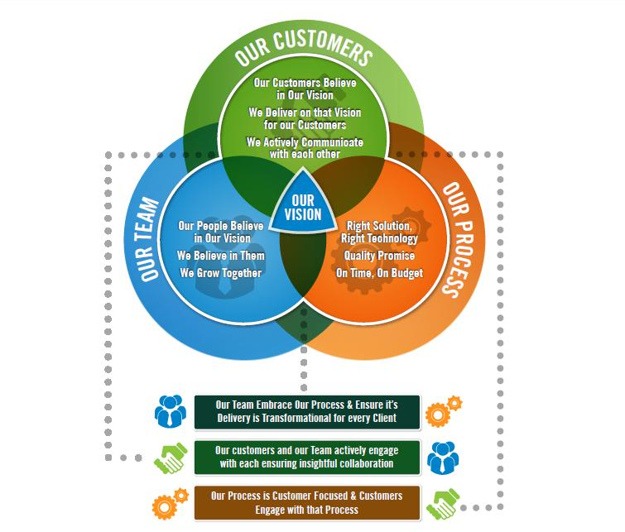
Our Vision
Our vision is to become our customers most trusted software partner by adding real value to their business through collaborative innovation, technical adaptability and agile engagement.

Slide 4














Our Clients

Slide 5





Our Focus
Primary Market
Medical Device &
Pharma
Alignment to Lean
Operational Excellence
& Shingo
Visualisation
Real-time KPIs
Actionable Insights
Empowerment through Technology
Decision Support Tools for Associates and Management
Increasing Efficiencies
Add Value & Reduce Costs
Unlock the Potential
Optimise your existing systems
Notes:
We utilise Iconics technologies and toolkits to develop solutions for the Life Sciences and General Manufacturing
We work very closely with companies who are focused on Continuous Improvement and Operational Excellence, and companies who have achieved or are on the journey to achieve Shingo.
KPI Visualisation is a key focus area for us and there is huge demand for delivering systems which ultimately empower people to make more informed decisions including providing front line Operations staff with the necessary decision support tools to help them identify areas of opportunity and deliver cost savings and efficiency gains
We see ourselves as being the Technology Partner for these companies and help them apply technology to the Lean practices.

Slide 6






Our Offerings
Software
Development
Validation
& SQA
Managed
Maintenance
Big Data
& Analytics
Our Lean
Products
IoT &
Industry 4.0
Notes:
We utilise Iconics technologies and toolkits to develop solutions for the Life Sciences and General Manufacturing
We work very closely with companies who are focused on Continuous Improvement and Operational Excellence, and companies who have achieved or are on the journey to achieve Shingo.
KPI Visualisation is a key focus area for us and there is huge demand for delivering systems which ultimately empower people to make more informed decisions including providing front line Operations staff with the necessary decision support tools to help them identify areas of opportunity and deliver cost savings and efficiency gains
We see ourselves as being the Technology Partner for these companies and help them apply technology to the Lean practices.

Slide 7






Technologies & Platforms
.NET Technologies
Analytics & Visualization
ICONICS
Microsoft Power BI
System & Data Integration
Iconics
CRM/XRM
Sharepoint
Cloud
Qlik
Informatica
Microsoft
Tableau
Notes:
Members of the Microsoft ISV Programme
.NET Technologies & Cloud Computing
CRM / XRM
Data Analytics & Visualisation
Real time Performance Monitoring of KPIs
Manufacturing Intelligence
Transaction Management and Integration
Analytics & Reporting
Partnership with Datanet Quality Systems
SPC Distributor and Integrator in Ireland

Slide 8
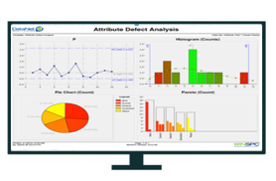
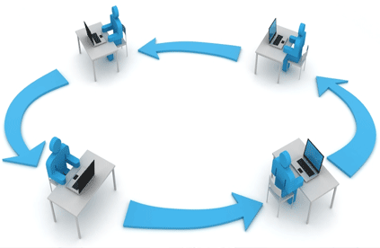
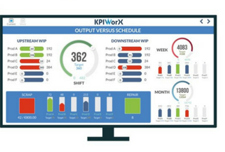
Our Software Solutions
Manufacturing Execution Systems
eDHR / eBR
Statistical Process Control
Workflow Automation
Web Based Dashboards
Real-time Visualisation
Notes:
We utilise Iconics technologies and toolkits to develop solutions for the Life Sciences and General Manufacturing
We work very closely with companies who are focused on Continuous Improvement and Operational Excellence, and companies who have achieved or are on the journey to achieve Shingo.
KPI Visualisation is a key focus area for us and there is huge demand for delivering systems which ultimately empower people to make more informed decisions including providing front line Operations staff with the necessary decision support tools to help them identify areas of opportunity and deliver cost savings and efficiency gains
We see ourselves as being the Technology Partner for these companies and help them apply technology to the Lean practices.

Slide 9

Our Validation Services
Software Validations
Equipment & Automation Validations
Technical Writing
Compliance
Data Integrity
Regulations – GAMP5 / FDA
Notes:
We utilise Iconics technologies and toolkits to develop solutions for the Life Sciences and General Manufacturing
We work very closely with companies who are focused on Continuous Improvement and Operational Excellence, and companies who have achieved or are on the journey to achieve Shingo.
KPI Visualisation is a key focus area for us and there is huge demand for delivering systems which ultimately empower people to make more informed decisions including providing front line Operations staff with the necessary decision support tools to help them identify areas of opportunity and deliver cost savings and efficiency gains
We see ourselves as being the Technology Partner for these companies and help them apply technology to the Lean practices.

Slide 10


Our Products
A3
Structured Problem Solving
Production Tracking
eDHR/eBR
21 CFR Pt.11
Web based
Real-time KPI Visualisation
Asset Level
Versus Target
Shift Context
Central Repository
Secure Data
Collaboration
Workflow
Notes:
We utilise Iconics technologies and toolkits to develop solutions for the Life Sciences and General Manufacturing
We work very closely with companies who are focused on Continuous Improvement and Operational Excellence, and companies who have achieved or are on the journey to achieve Shingo.
KPI Visualisation is a key focus area for us and there is huge demand for delivering systems which ultimately empower people to make more informed decisions including providing front line Operations staff with the necessary decision support tools to help them identify areas of opportunity and deliver cost savings and efficiency gains
We see ourselves as being the Technology Partner for these companies and help them apply technology to the Lean practices.

Slide 11
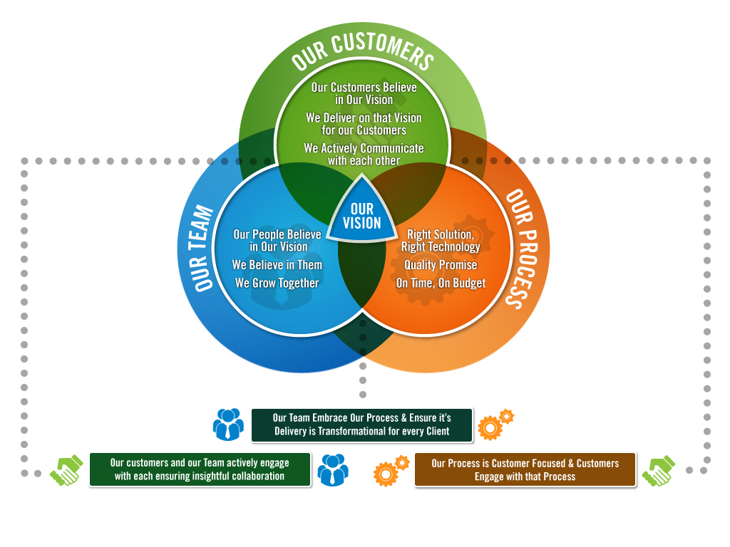

Achieving our Vision

Slide 12
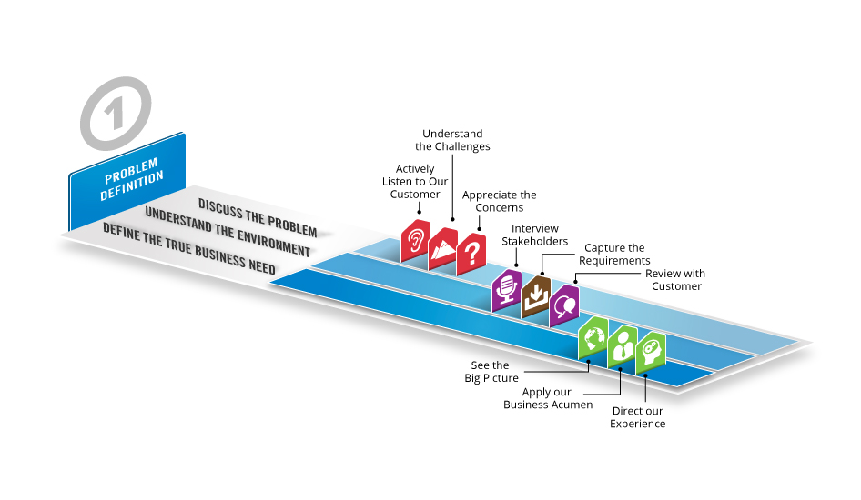
Our Process Step 1

Slide 13
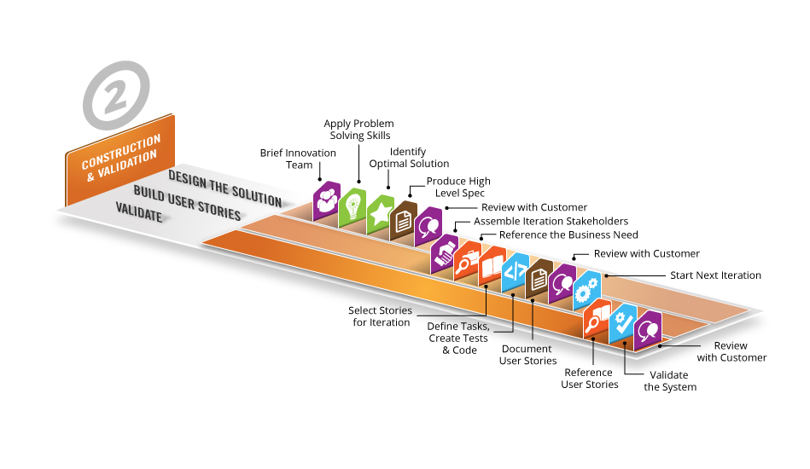
Our Process Step 2

Slide 14
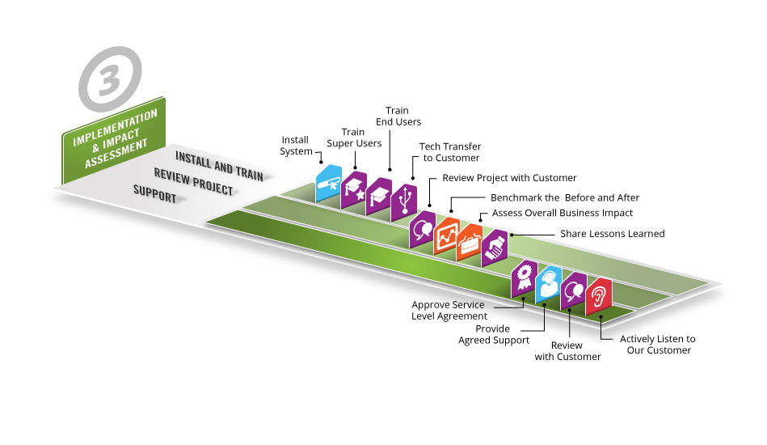
Our Process Step 3
Notes:
Red listening - Blue building - Orange referencing - Green defining - Brown documenting – purple communicating

Slide 15
Achieving our Vision

Slide 16
Innovation Program
Gather ideas
Part of the process, Site visit sheets, Staff weekly meetings, Off-site sessions
Define ideas
Presented by the originator
Phase One Justification
USP, Marketable, Profitability, aligned to strategy
Initial research
Financial analysis, Competitor analysis, Market Research
Phase Two Justification
Lean Canvas Tool
Project Implementation

Slide 17

Will have a sample question template (Questions from Sean )
Compile a list of upcoming events of interest - ongoing
Staff should be aware to look for new ideas from any customer interactions
Meetings with Potential Customers
3 per Quarter?
(Liam/ Brian)
Meetings with Existing Customers
3 Per Quarter?
(Liam/Brian/
Leona/Senior Engineers)
Seminars, Open Days, Events
1 per quarter
Customer Project Reviews
Held at the end of Each project
(Liam/Brian and the project Manager)
Internet blogs, Forums or discussions from groups on Linked In
Continuous
(All)
Customer Project Meetings
Continuous
(Senior Engineer/Project Manager)
Timesheets
An option to complete an Innovation Feedback Form will appear every time a customer meeting is recorded in a timesheet
(All Staff Members)
Staff Meetings
Every Quarter
(Liam/Brian with individual Staff members)
Innovation Feedback Form
Review Innovation Feedback Form to decide if it should be moved to the next stage of the process
(Leona)
Review of Timesheet entries to ensure the Innovation Feedback form is completed
Weekly ( Leona )
Post Meeting Form
Completed after each meeting to log any issues or ideas that have arisen
(Liam/Brian)
Ideas Excel Sheet
Individuals Logging Ideas
Continuous
(All)
Ideas Generation Workshops
Half day every 6 months
(All in attendance, chaired by Sam)
Innovation Process Begins

Slide 18
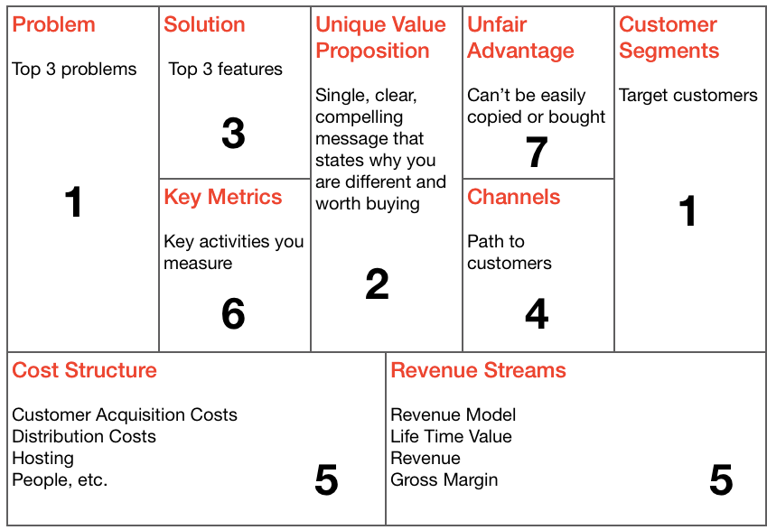
Courtesy of Sean McNulty Innovator

Slide 19
Technology Program
Technologies to be considered
Technologies to be investigated
Technologies to be added to a project
Technologies that need feedback to the Tech group
Technologies that should be demonstrated to all staff
Technologies that need to be documented
Adopted technologies
Notes:
Training – Masters course

Slide 20
Achieving our Vision

Slide 21
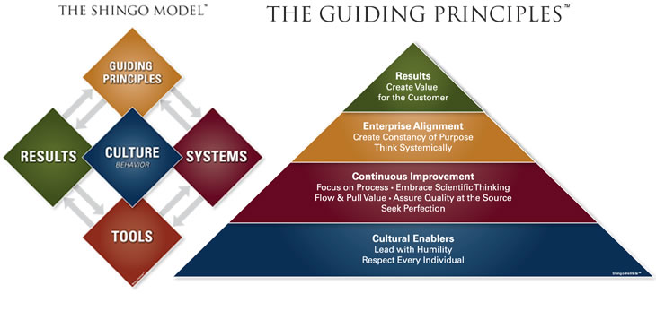
What is Shingo
Tools : Single device or item that accomplishes a task
System : Collection of Tools or tasks that are integrated to accomplish an outcome
Culture : Values, Beliefs, Behaviours
Notes:
Systems should tie into your strategy and the culture you are trying to build
Shingo really focuses on principles and behaviours.
We can all fall into the trap of plucking systems and tools and using them in isolation – may get some quick wins but then you get the Caffeine Kick and then the Dive

Slide 22
Our Principles
Respect every Individual
We respect every individual because everyone has something to contribute and should be listened to. We promote a culture of participation, openness and creativity where everyone’s opinion is respected. All feedback shall be constructive and all interactions should be done in a polite manner
Lead with Humility
Create Constancy of Purpose
We all believe in our vision and we communicate regularly internally and with our customers to ensure we support each other in achieving our objectives.
We promote a coaching culture in a positive environment where our people are empowered and feel valued. We trust our team and support personal and professional development
Assure Quality at Source
We have pride in our work and promote Right First Time through coaching, regular reviews and following procedures. Attention to detail is paramount
Focus on Process
We believe that standardisation and processes can help people achieve their true potential and help add value to our customers. We believe that it is essential that we continually review our processes to ensure that they do not stifle innovation or reduce flexibility
Seek Perfection
Create Value for Our Customers
We believe that every interaction with our customer should strive to deliver real value by helping them reduce waste, improve efficiency and streamline their processes
We support a culture of continuous improvement at an individual, team and company level to enable us to achieve our vision
Scientific Thinking
We embrace scientific thinking by ensuring all our decisions are informed by evidence. We encourage the use of structured methodologies and an holistic approach to problem solving

Slide 23
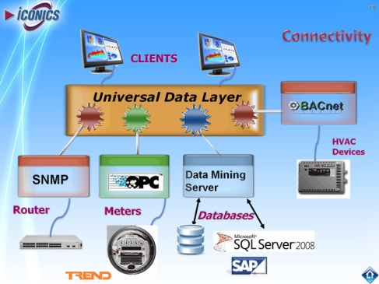
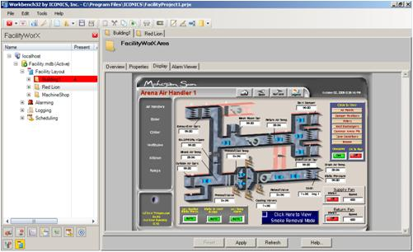
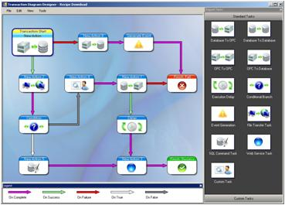
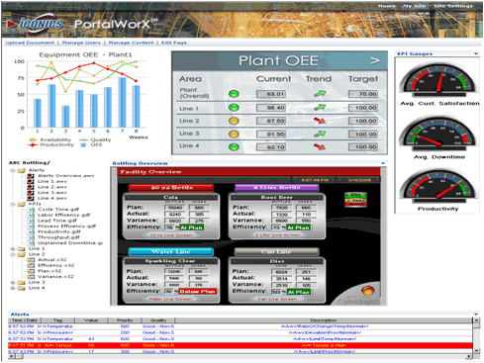
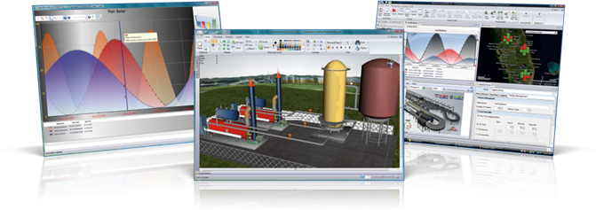
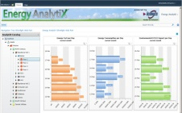
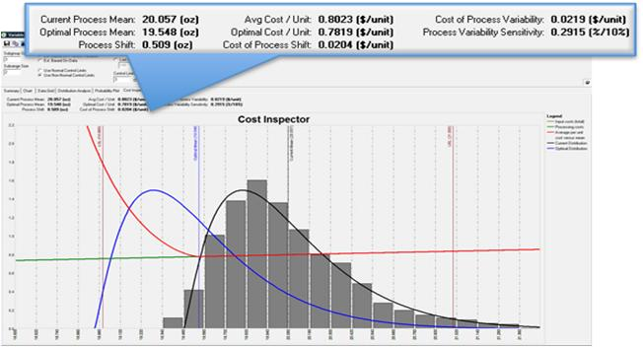
What We Use ICONICS For
Connectivity
SCADA
Data Bridging & Aggregation
Real Time Performance Management
Building & Energy Management
Plant Wide Analytics & Intelligence Dashboard

Slide 24


Iconics Projects – T5
Europe’s Largest Construction Project
Over £6 Billion
Integrates over 20+ Systems:
Security
Lighting
People Movers
Building Automation
Baggage Handling
Moving Walkways
Elevators
Jetways
Billing Systems
Etc…

Slide 25
